Slide 1
NAME: MR NDIRANGU
SCHOOL: NJAHI SECONDARY
SUBJECT: CHEMISTRY
TOPIC : CHEMICAL FAMILIES
SUB TOPIC : ALKALI METALS
COUNTY : KIAMBU

Slide 2
OBJECTIVES
At the end the lesson learners should be able to:
1) identify alkali metals
2) write the electronic arrangements of alkali metals
3) state and explain the trends in physical properties of alkali metals.
4) state uses of sodium metal and it's compounds.

Slide 3
FORM two chemistry
Alkali metals

Slide 4
Introduction
Look at the following pictures:

Slide 5
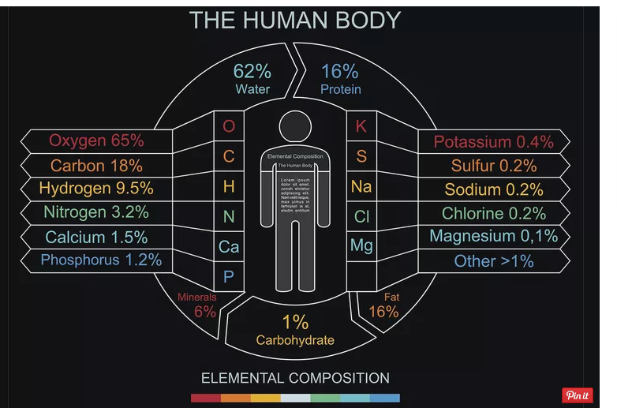

Slide 6
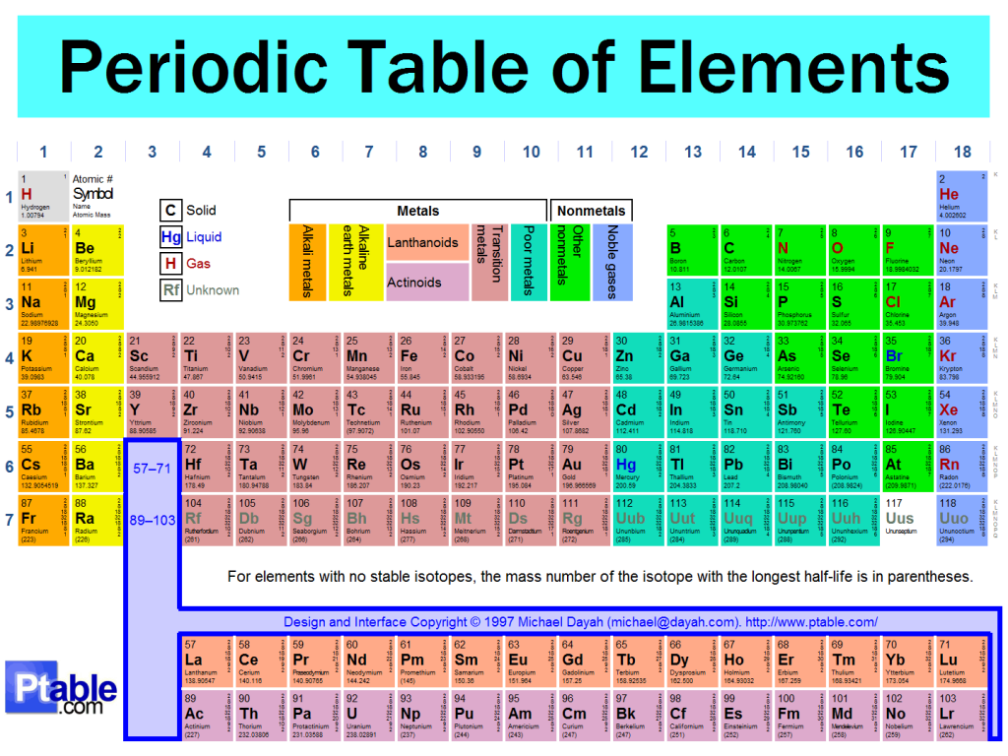

Slide 7
IDENTIFY THE GROUP ONE ELEMENTS/ ALKALI METALS

Slide 8
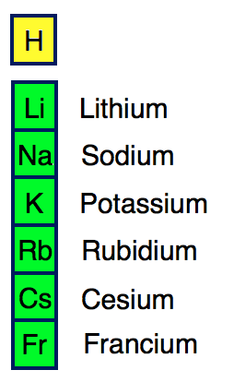

Slide 9
Watch the video below
State and explain the trend in the following properties down the group …….

Slide 10
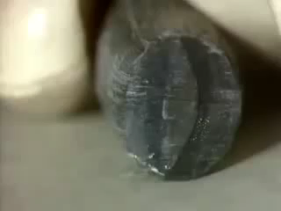

Slide 11
PROPERTIES OF ALKALI METALS
ATOMIC RADIUS
IONIC RADIUS
IONIZATION ENERGY
APPEARANCE
HARDNESS/EASE OF CUTTING
MELTING AND BOILING PONTS
ELECTRICAL CONDUCTIVITY

Slide 12
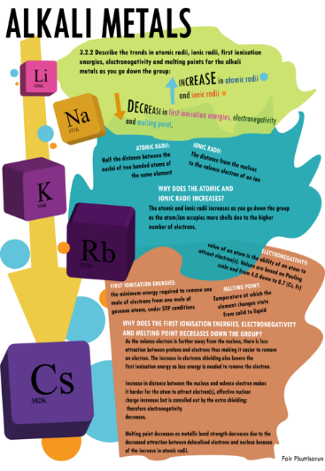

Slide 13
GROUP I ELEMENTS: ALKALI METALS
Group I elements are called Alkali metals except Hydrogen which is a non metal.
The alkali metals include:
Element | Symbol | Atomic number | Electron structure | Oxidation state | Valency
Lithium | Li | 3 | 2:1 | Li⁺¹ | 1
Sodium | Na | 11 | 2:8:1 | Na⁺¹ | 1
Potassium | K | 19 | 2:8:8:1 | K⁺¹ | 1
Rubidium | Rb | 37 | 2:8:18:8:1 | Rb⁺¹ | 1
Caesium | Cs | 55 | 2:8:18:18:8:1 | Cs⁺¹ | 1
Francium | Fr | 87 | 2:8:18:32: 18:8:1 | Fr⁺¹ | 1

Slide 14
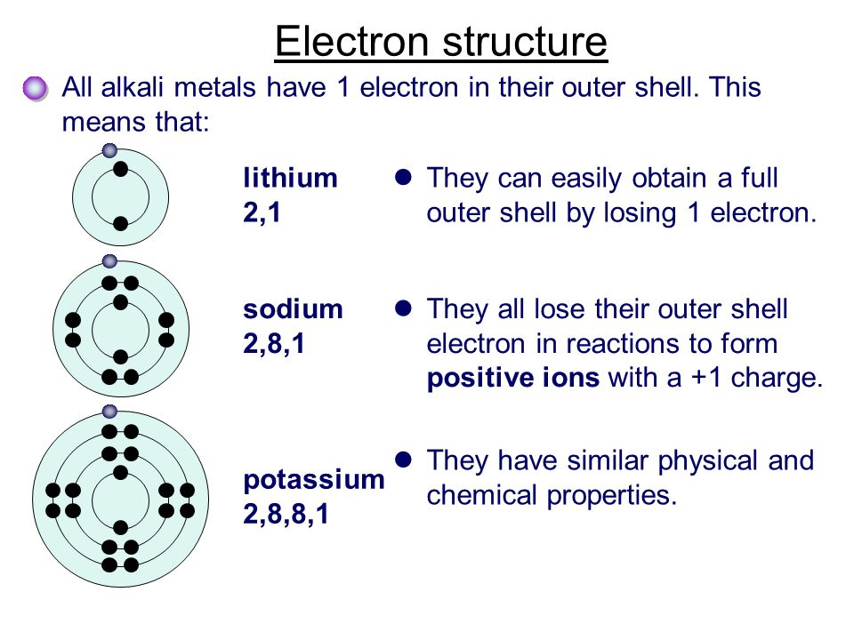

Slide 15
ALKALI METALS
Li
Na
K

Slide 16
Table showing the atomic and ionic radius of some alkali metals pg 27
Element | Symbol | Atomic number | Atomic radius (nM) | Ionic radius (nM)
Lithium | Li | 3 | 0.133 | 0.060
Sodium | Na | 11 | 0.157 | 0.095
Potassium | K | 19 | 0.203 | 0.133

Slide 17
ATOMIC SIZE/RADIUS of alkali metals.
Atomic Radius is the distance between the centre of the nucleus and the occupied outermost energy level.
NB:: The atomic size increases down the group.
Atomic radius is measured in nanometers(n).
The bigger the atomic radius the larger the atomic size.
Reasons: The number of energy levels increases down the group from Lithium to potasium /Francium.
The more the number of energy levels the larger the atomic size. e.g.
The atomic size of Potassium is larger than that of sodium because Potassium has more(4) energy levels than sodium which has (3) energy levels.

Slide 18
CONCLUSION
The atomic radius of alkali metals is bigger than the ionic radius.
This is because alkali metals react by losing/donating the outer electron and hence lose the outer energy level

Slide 19
ionic radius
The distance between the centre of the nucleus of an ion and the outermost energy level occupied by electron/s is called ionic radius.
Ionic radius is also measured in nanometers(n).
The bigger the ionic radius the larger the size of the ion.

Slide 20
Ionization energy
The minimum amount of energy required to remove an electron from an atom of element in its gaseous state.
The SI unit of ionization energy is kilojoules per mole/kJmole⁻¹ .
Ionization energy depend on atomic radius.
The higher the atomic radius, the less the nuclear attraction on outer electrons/energy level and thus the lower the ionization energy.
For alkali metals the ionization energy decrease down the group as the atomic radius increase and the nuclear attraction on outer energy level electrons decrease.

Slide 21
PHYSICAL PROPERTIES OF ALKALI METALS
ASSIGNMENT
State and explain the trends in following properties of alkali metals down the group?
1. appearance … silvery white/grey
2.ease of cutting
3.melting and boiling points
3. electrical conductivity

Slide 22
Summary of some physical properties of the 1st three alkali metals
Alkali metal | Appearance | Ease of cutting | Melting point (ºC) | Boiling point (ºC) | Conductivity | ionization energy
Lithium | Silvery white | Not easy | 180 | 1330 | Good | 520
Sodium | Shiny grey | Easy | 98 | 890 | Good | 496
Potassium | Shiny grey | Very easy | 64 | 774 | Good | 419

Slide 23
Appearance:
Alkali metals have a shiny grey metallic luster when freshly cut.
The surface quickly tarnishes (turns to dull) on exposure to air. This is because the metal surface quickly reacts with elements of air/oxygen.
Melting and boiling points:
Alkali metals have a relatively low melting/boiling point than common metals like Iron.
This is because alkali metals use only one delocalized electron to form a weak metallic bond/structure.
The m.pt and b.pt decreases down the group.
Electrical/thermal conductivity:
Alkali metals are good thermal and electrical conductors. Metals conduct using the outer mobile delocalized electrons. The delocalized electrons move randomly within the metallic structure.

Slide 24
Activity 2
1.With reference to the table above ,construct or design an infographics showing the physical properties of alkali metals .

Slide 26
Record all uses of sodium shown in the slide above

